Slide 1
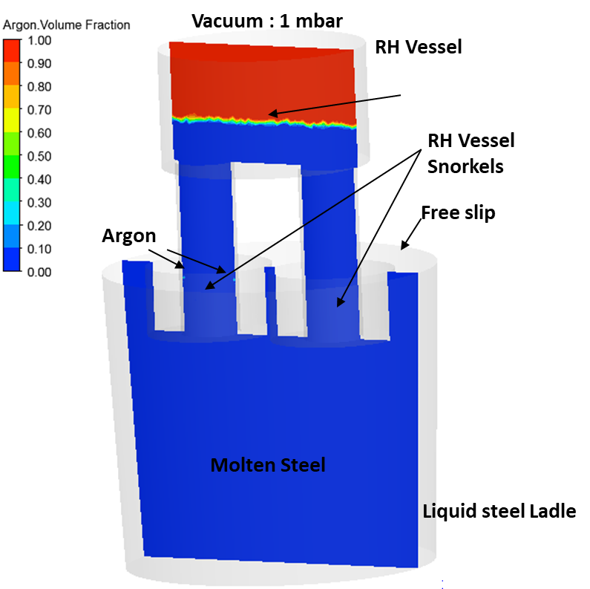
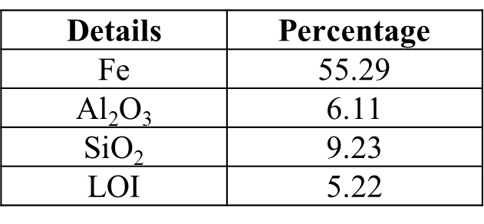
Title (Arial 40, Bold, Colour : RGB (18,73,155)
Authors (Arial 36, Normal, Black) – presenting author to be underlined
Affiliation (Arial 36, Normal, Black)
Title Box Background Colour : RGB (222, 235, 247)
Paragraph Headings [Arial 30, bold, Colour : RGB (18,73,155)] : Paragraph Text, Arial 28, Normal, Black
Presentation Flow
Introduction/Background
Objective
Materials and Methods
Results and Discussion
Conclusions
Fig.no [Arial 28, bold, Colour : RGB (18,73,155)] Figure Caption, Arial 28, Normal, Black
(figure no. and caption to be written in-line)
Themes
Mineral Processing – Ferrous, Non-ferrous and Coal
Ironmaking and Steelmaking
Non-ferrous Metal Processing
Solidification and Continuous Casting
Metal Forming - Hot Rolling, Cold Rolling, Forging and Drawing
Metal Joining – Ferrous and Non-ferrous
Powder Metallurgy and Additive Manufacturing
Bio-Materials, Smart Materials and Functional Materials
Integrated Computational Materials Engineering (ICME), Modeling and Simulation
Digitalization and Industry 4.0
Structure Property Correlation
Failure Analysis
Environment and Sustainability
Refractories, Ceramics and Composites
Materials for Strategic Sectors - Defence, Nuclear and Aerospace
Corrosion, Electrochemistry, Batteries and Fuel Cells
Archaeo-metallurgy
Table No [Arial 28, bold, Colour : RGB (18,73,155)]
Table Caption, Arial 28, Normal, Black
(table caption to be written in next line)

